Slide 1
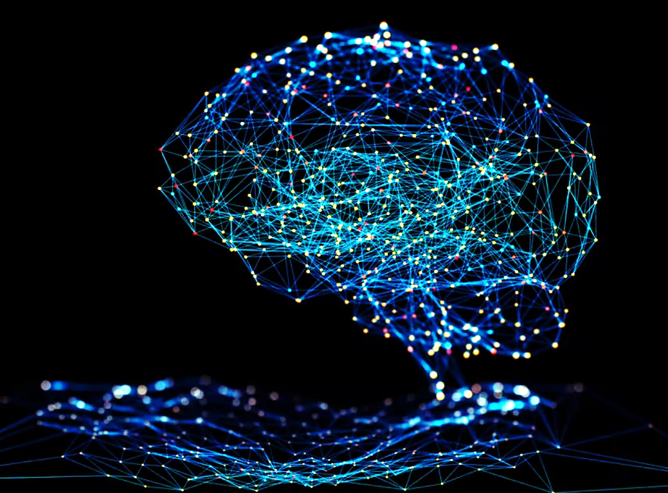
Convolutional Neural Network

Slide 2
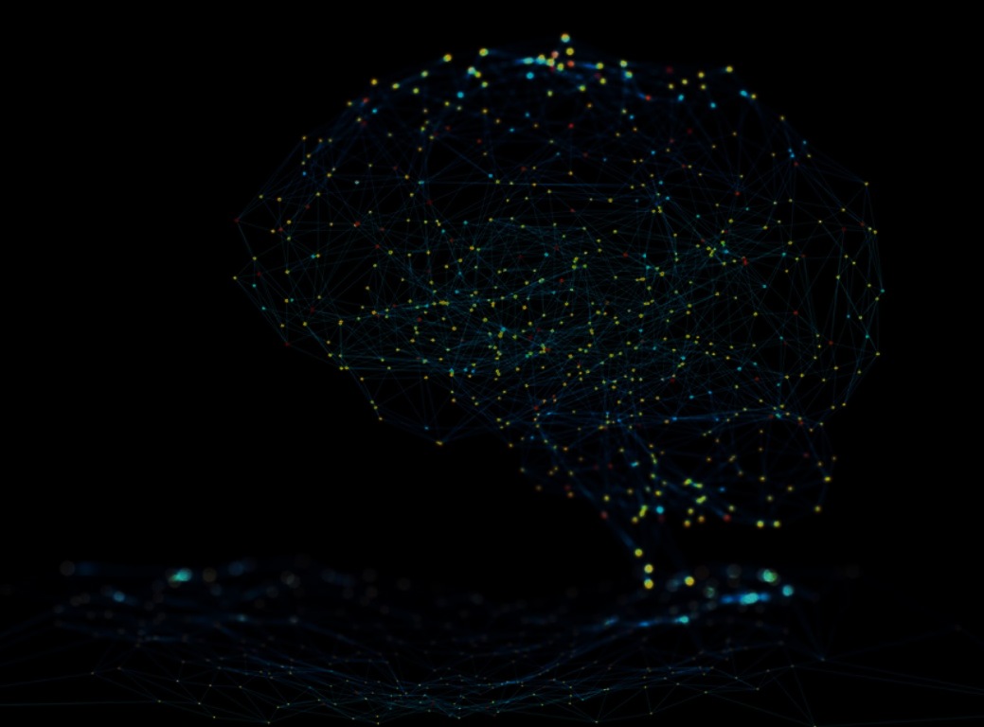
Intro to Neural Network
neural network is a computer program that operates in a manner inspired by the natural neural network in the brain.
The objective of such artificial neural networks is to perform such cognitive functions as problem solving and machine learning.
The theoretical basis of neural networks was developed in 1943 by the neurophysiologist Warren McCulloch of the University of Illinois and the mathematician Walter Pitts of the University of Chicago.
In 1954 Belmont Farley and Wesley Clark of the Massachusetts Institute of Technology succeeded in running the first simple neural network.
Neural networks are a part of deep learning

Slide 3
Work of Neural network
Neural network need to use big data in training neural networks. They work because they are trained on vast amounts of data to then recognize, classify and predict things.
In the driverless cars example, it would need to look at millions of images and video of all the things on the street and be told what each of those things is. And tell what action need to be take
A neural network is a network of artificial neurons programmed in software. It tries to simulate the human brain, so it has many layers of “neurons” just like the neurons in our brain.
A simple neural network includes an input layer, an output layer and, in between, a hidden layer. The layers are connected via nodes, and these connections forms a “network” – the neural network of interconnected nodes.

Slide 4
Work of Neural network
The “building blocks” of neural networks are the neurons.
In technical systems, we also refer to them as units or nodes.
Basically, each neuron
receives input from many other neurons.
changes its internal state (activation) based on the current input.
sends one output signal to many other neurons, possibly including its input neurons (recurrent network).
In biological systems, one neuron can be connected to as many as 10,000 other neurons.

Slide 5
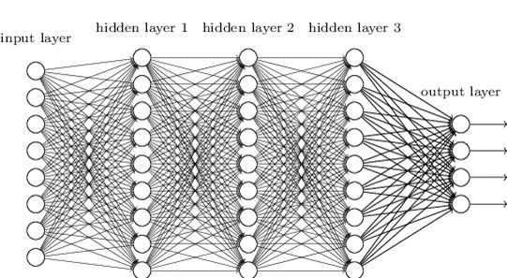
Work of Neural network
The first layer of neurons will receive inputs like images, video, sound, text, etc. This input data goes through all the layers, as the output of one layer is fed into the
next layer.

Slide 6
What is Convolutional neural network
a convolutional neural network (CNN, or ConvNet) is a class of artificial neural network
A Convolutional neural network (CNN) is a neural network that has one or more convolutional layers and are used mainly for image processing, classification, segmentation and also for other auto correlated data
A Convolutional Neural Network (CNN) is a Deep Learning algorithm which can take in an input image, assign importance (learnable weights and biases) to various aspects/objects in the image and be able to differentiate one from the other.
The pre-processing required in a CNN is much lower as compared to other classification algorithms.

Slide 7
Working of CNN
A Convolutional neural network has three layers.
Convolutional Neural Networks have the following layers:
Convolutional
Rectified Linear Unit (ReLU) Layer
Pooling

Slide 8
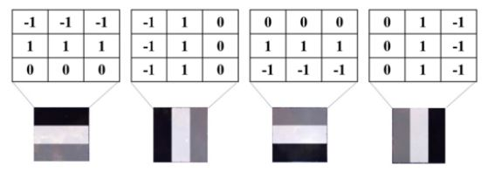
Working of CNN
Convolutional
This layer work on basis of filtering image data
The filter is a matrix of integers that are used on a subset of the input pixel values
It has many filter matrices for image processing for detecting data like if image having loop, vertical/horizontal edge which shown bellow

Slide 9
Working of CNN
Convolutional
Convolutional kernels:
Each convolutional layer contains a series of filters known as convolutional kernels. The filter is a matrix of integers that are used on a subset of the input pixel values, the same size as the kernel.
Each pixel is multiplied by the corresponding value in the kernel, then the result is summed up for a single value for simplicity representing a grid cell, like a pixel, in the output channel/feature map.
In computer vision the input is often a 3 channel RGB image. For simplicity, if we take a greyscale image that has one channel (a two dimensional matrix) and a 3x3 convolutional kernel (a two dimensional matrix). The kernel strides over the input matrix of numbers moving horizontally column by column, sliding/scanning over the first rows in the matrix containing the images pixel values. Then the kernel strides down vertically to subsequent rows.

Slide 10
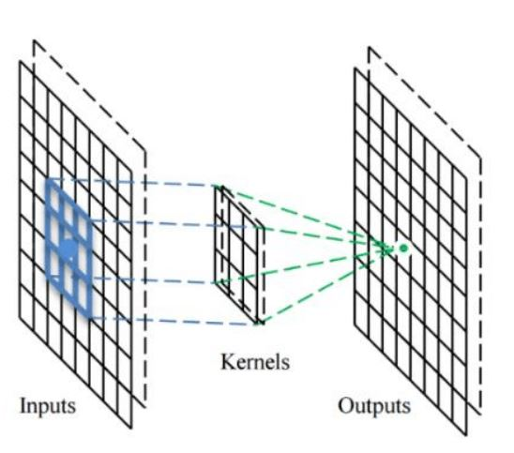
Working of CNN
Convolutional
Convolutional kernels:

Slide 11
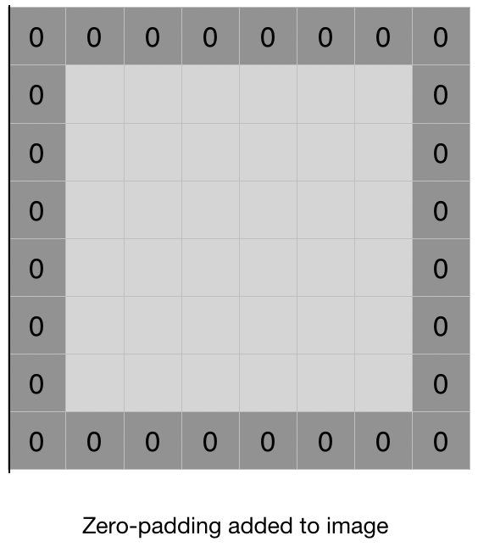
Working of CNN
Padding
In normal convolution we can apply filter to pixel of image but edge pixel are not use in more calculation so data loss happen
If we apply 3 X 3 filter matrix to 8 X 8 pixel matrix then then we get data of
6 X 6 matrix so data loss, to reduce data loss we use padding concept
In padding concept we add one pixel around outside of data
For 5X5 matric it become 2 pixel (formula is floor(filter/2))
Two type of padding :
Padding with zero value pixels :- padding pixel fill by zeros
Reflection padding :- padding pixel fill by according to neighbor

Slide 12
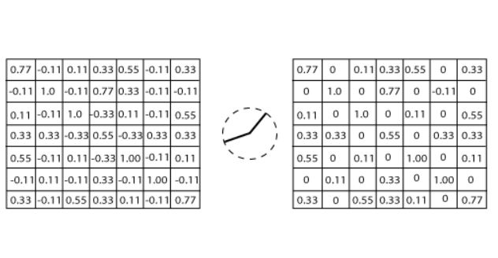
Working of CNN
Rectified Linear Unit (ReLU) Layer
In this layer, we remove every negative value from the filtered images and replaces them with zeros.
Rectified Linear unit transform functions only activates a node if the input is above a certain quantity. While the data is below zero, the output is zero, but when the information rises above a threshold. It has a linear relationship with the dependent variable.

Slide 13
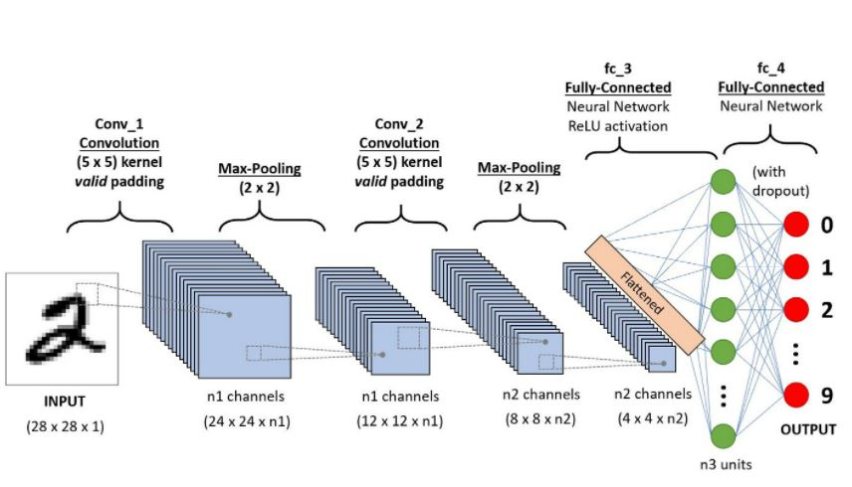
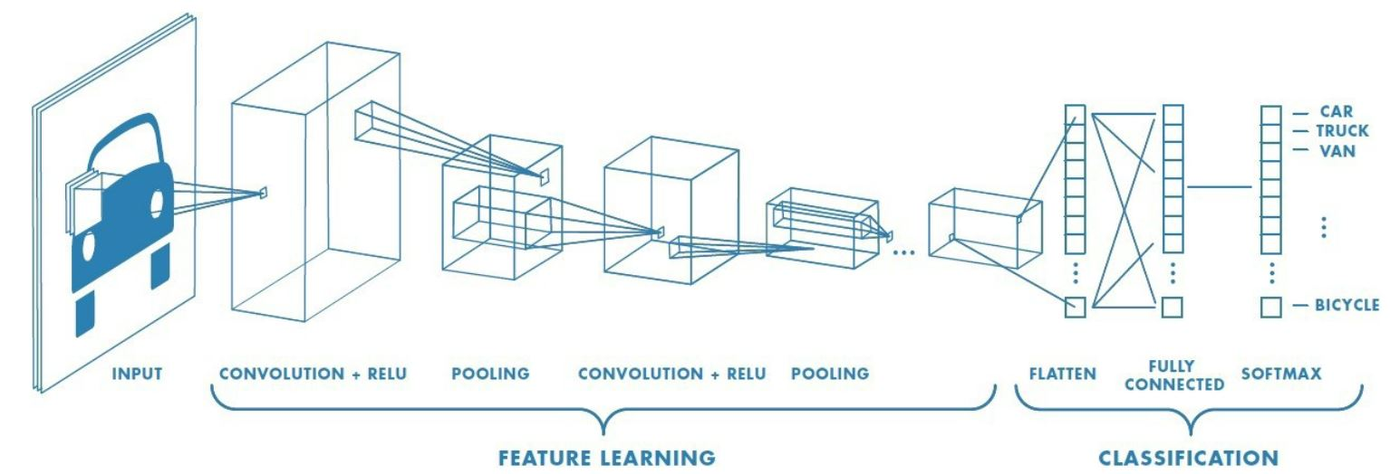
Working of CNN

Slide 14
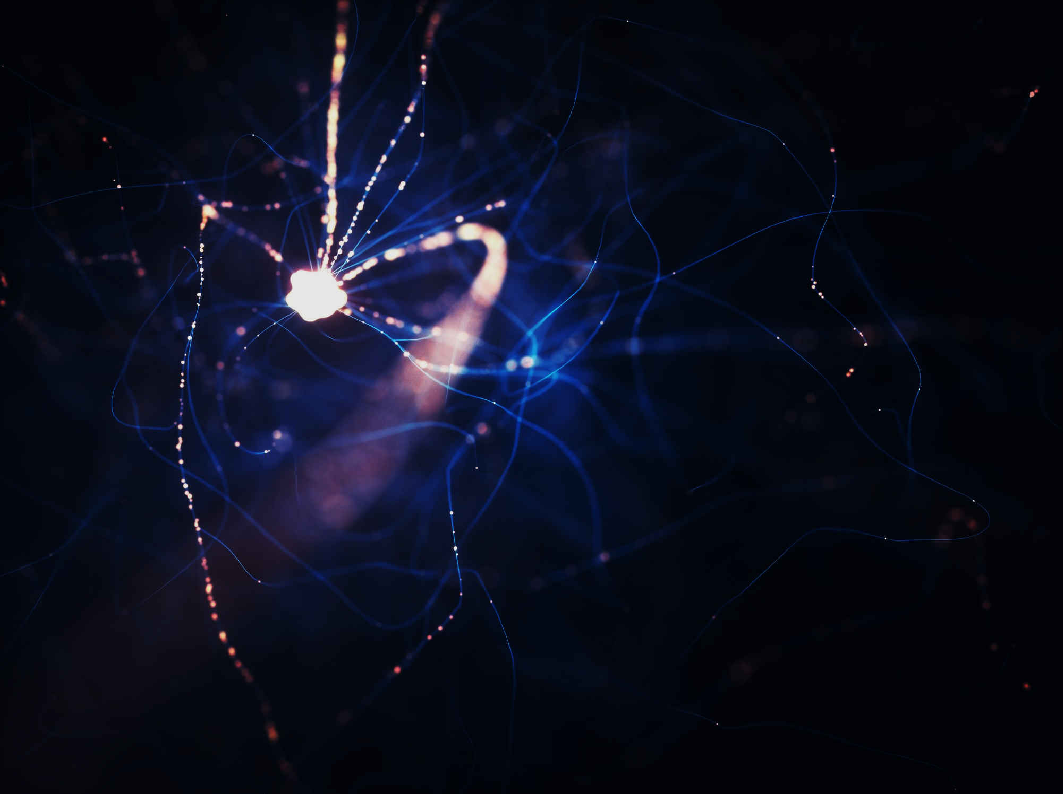
Recurrent Neural Network

Slide 15
Intro to Recurrent Neural Network
Recurrent Neural Networks or RNNs , are a very important variant of neural networks heavily used in Natural Language Processing .
They’re are a class of neural networks that allow previous outputs to be used as inputs while having hidden states.
RNN has a concept of “memory” which remembers all information about what has been calculated till time step t.
RNNs are called recurrent because they perform the same task for every element of a sequence, with the output being depended on the previous computations.
in order to handle sequential data successfully, you need to use recurrent (feedback) neural network. It is able to ‘memorize’ parts of the inputs and use them to make accurate predictions.
These networks are at the heart of speech recognition, translation and more.

Slide 16
Why Recurrent Neural Network
In a general neural network, an input is fed to an input layer and is further processed through number of hidden layers and a final output is produced, with an assumption that two successive inputs are independent of each other or input at time step t has no relation with input at timestep t-1.
However this assumption is not true in a number of real-life scenarios. For instance, if one wants to predict the price of a stock at a given time or wants to predict the next word in a sequence then it is imperative that dependence on previous observations is considered.
You can see a little jumble in the words made the sentence incoherent
Don’t happy be worry
Cure is best prevention
Everything is war in fair and love
A day a doctor, keeps an apple away
Blood is in my cricket
sentences that we just saw above- the sequence of words define their meaning
time series data – where time defines the occurrence of events, the data of a genome sequence- where every sequence has a different meaning.

Slide 17
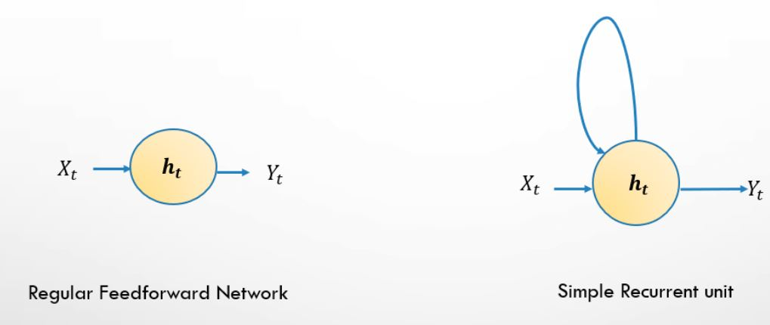
What Recurrent Neural Network
First, we need to train the network using a large dataset
we input one example at a time and produce one result, both of which are single words.
he difference with a feedforward network(ANN) comes in the fact that we also need to be informed about the previous inputs before evaluating the result.

Slide 18
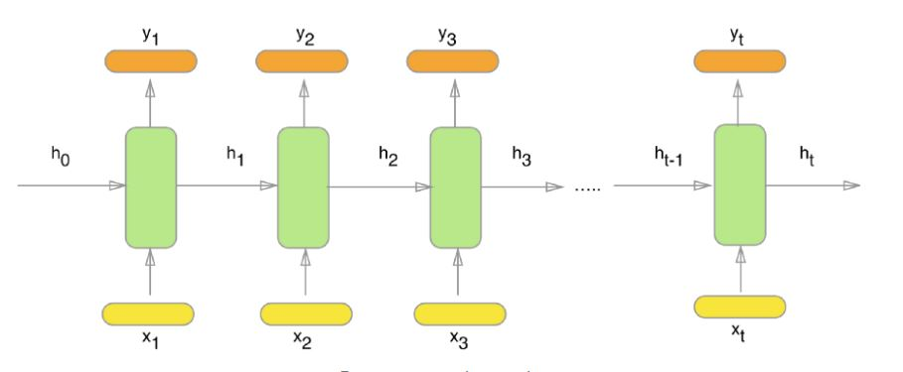
What Recurrent Neural Network
So you can view RNNs as multiple feedforward neural networks, passing information from one to the other.
Here x_1, x_2, x_3, …, x_t represent the input words from the text, y_1, y_2, y_3, …, y_t represent the predicted next words and h_0, h_1, h_2, h_3, …, h_t hold the information for the previous input words.
we need to encode the words into vectors. The best approach is to use one-hot encoded vectors

Slide 19
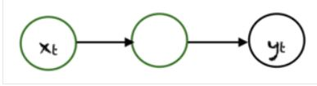
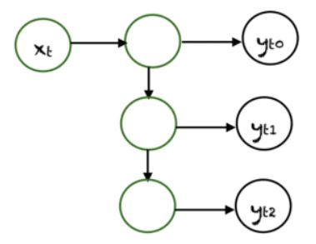
Type of Recurrent Neural Network
One To One
One To many
Here there is a single (xt,yt) pair. Traditional neural networks employ a one to one architecture.
In one to many networks, a single input at xt can produce multiple outputs, e.g., (yt0,yt1,yt2). Music generation is an example area, where one to many networks are employed.

Slide 20
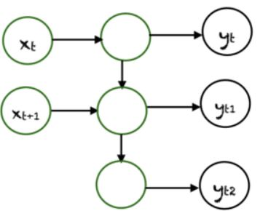
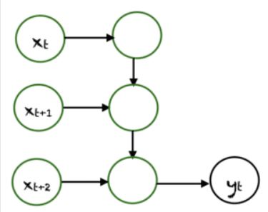
Type of Recurrent Neural Network
Many To One
Many To many
In this case many inputs from different time steps produce a single output. For example, (xt,xt+1,xt+2) can produce a single output yt. Such networks are employed in sentiment analysis or emotion detection, where the class label depends upon a sequence of words.
There are many possibilities for many to many. An example is shown above, where two inputs produce three outputs. Many to many networks are applied in machine translation.
e.g, English to French or vice versa translation systems.

Slide 21
Application of Recurrent Neural Network
Voice classification
For example you want to classify between male & female voices then you’d have sound samples from male & female voices.
input would be a voice sample of varying lengths, while output is of a fixed type and size.
Image Captioning
For tasks like Image captioning , we have a single input – the image, and a series or sequence of words as output.
Language Translation

